Slide 1
OBS Install Guide
March 2020

Slide 2
Open the downloader launcher (Click yes if it asks for permission)

Slide 3
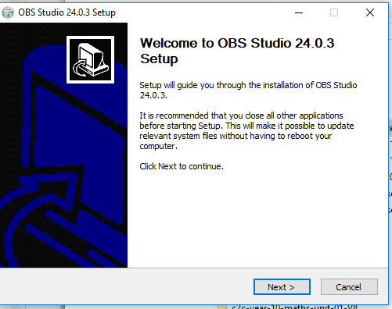
Click next

Slide 4
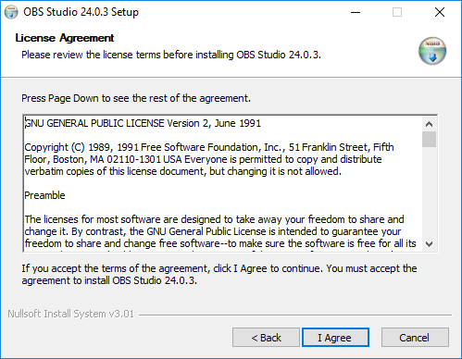
Click I Agree

Slide 5
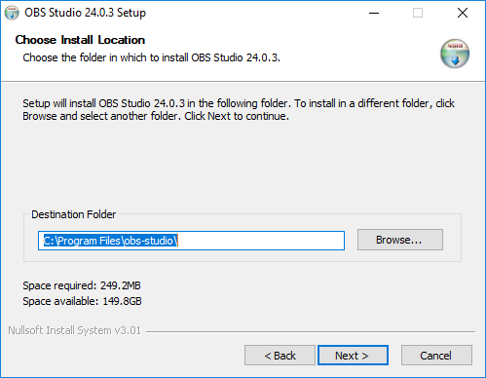
Click Next (only change the directory if you’re an advanced user)

Slide 6
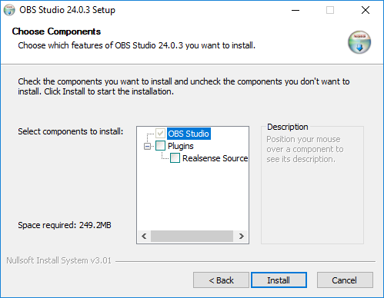
Click Install

Slide 7
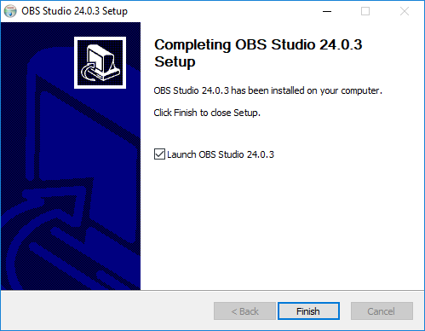
Click Finish

Slide 8
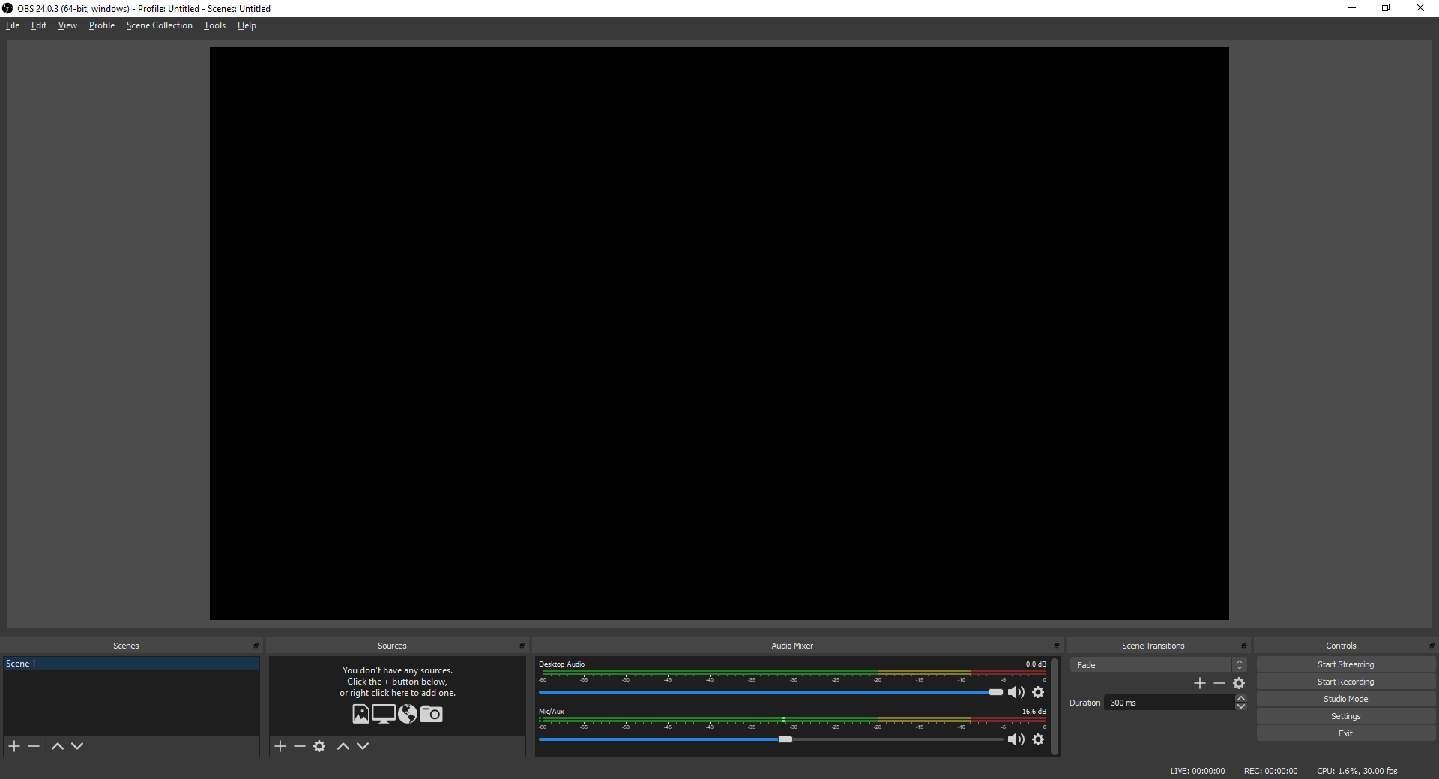
OBS Should Open By Default

Slide 9
Click The + button under sources

Slide 10
Click ‘Display Capture’

Slide 11
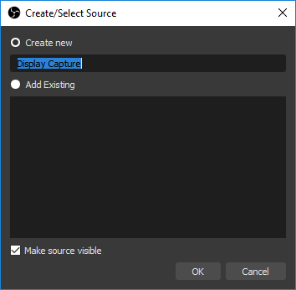
Leave create new selected click OK

Slide 12
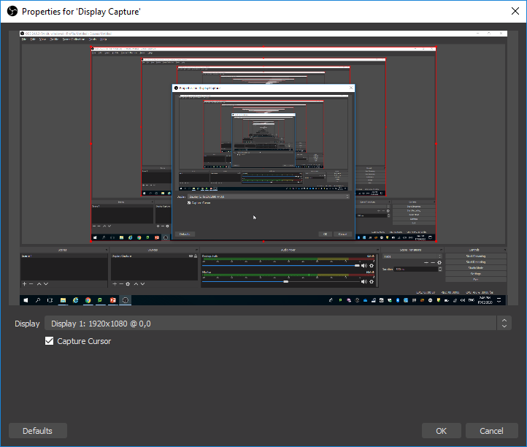
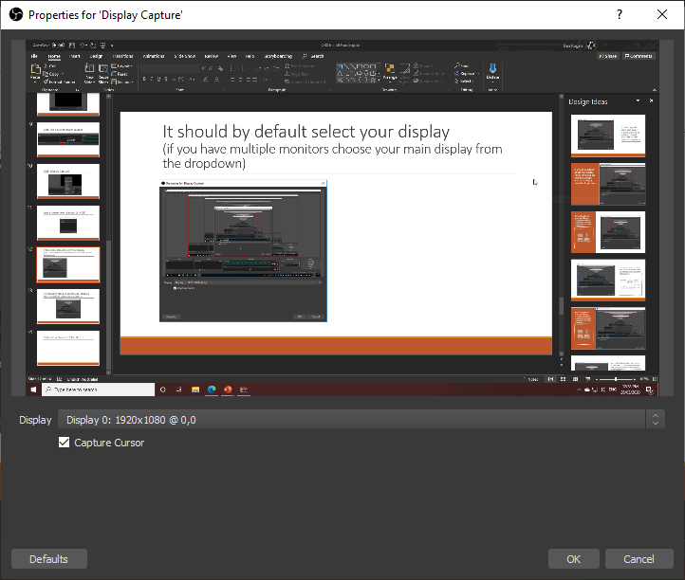
It should by default select your display (if you have multiple monitors choose your main display from the dropdown)

Slide 13
It should by default select your display Make sure capture cursor is ticked. Click OK

Slide 14
Please Resume The Video

